Slide 1
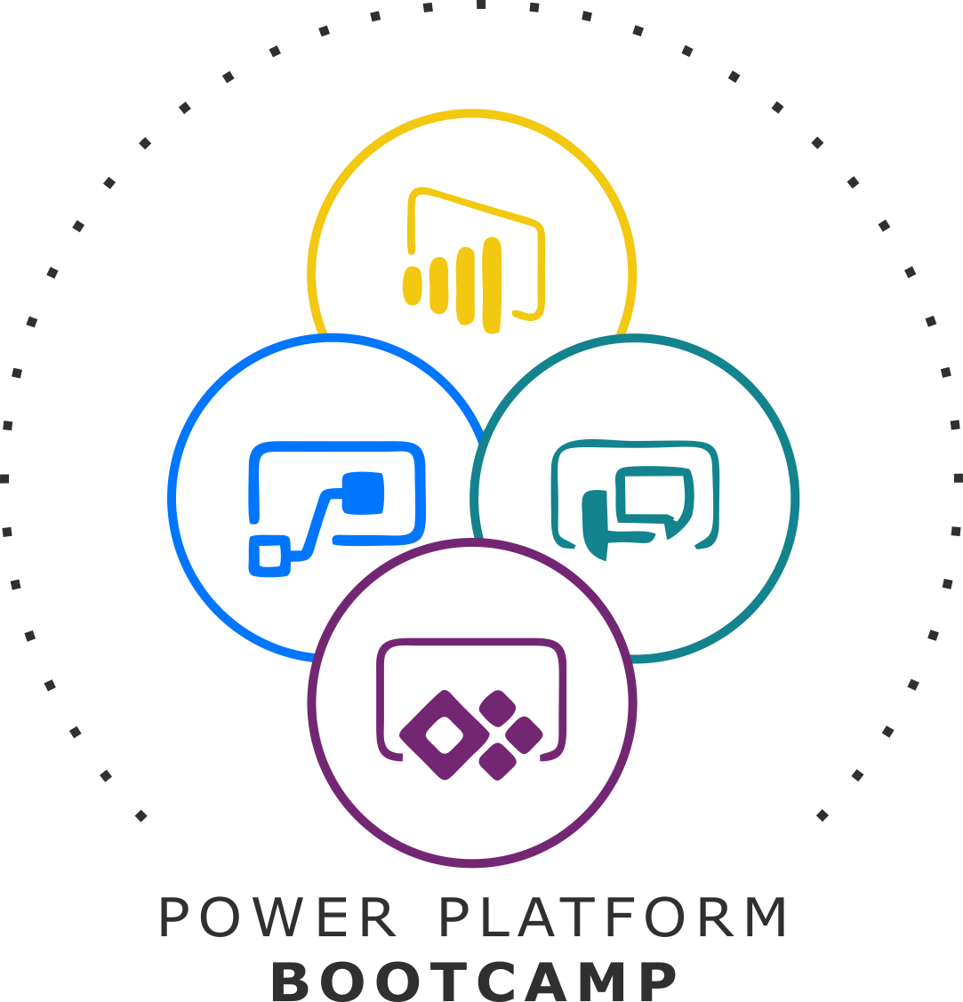



GLOBAL POWER PLATFORM BOOTCAMP
Organized Globally, Held Locally

Slide 2
A Deep Dive into PowerApps and Power Automate
Ajit Kadiya
Chandresh Pansuriya

Slide 3

Ajit Kadiya
SharePoint / Office 365 Consultant
SharePoint Consultant, TTEC India customer solution
Microsoft Certified Professional
Sharepointing since 2007

Slide 4

Chandresh Pansuriya
SharePoint / Office 365 Consultant
SharePoint Consultant, TTEC India customer solution
Microsoft Certified Professional
Sharepointing since 2007

Slide 5
Agenda
PowerApps New Features
PowerApps Test Studio
PowerApps Log telemetry
Demo

Slide 6
PowerApps New Features

Slide 7
Test Studio
Makers create and run tests for their applications
Test Studio provides a way to add and manage test cases, organize them into test suites, and run them to validate that changes in the apps did not break the expected functionality described in the tests.
Tests can also be run outside of the test studio in a web browser which allows you to build the automated tests into your app deployment processes.

Slide 8
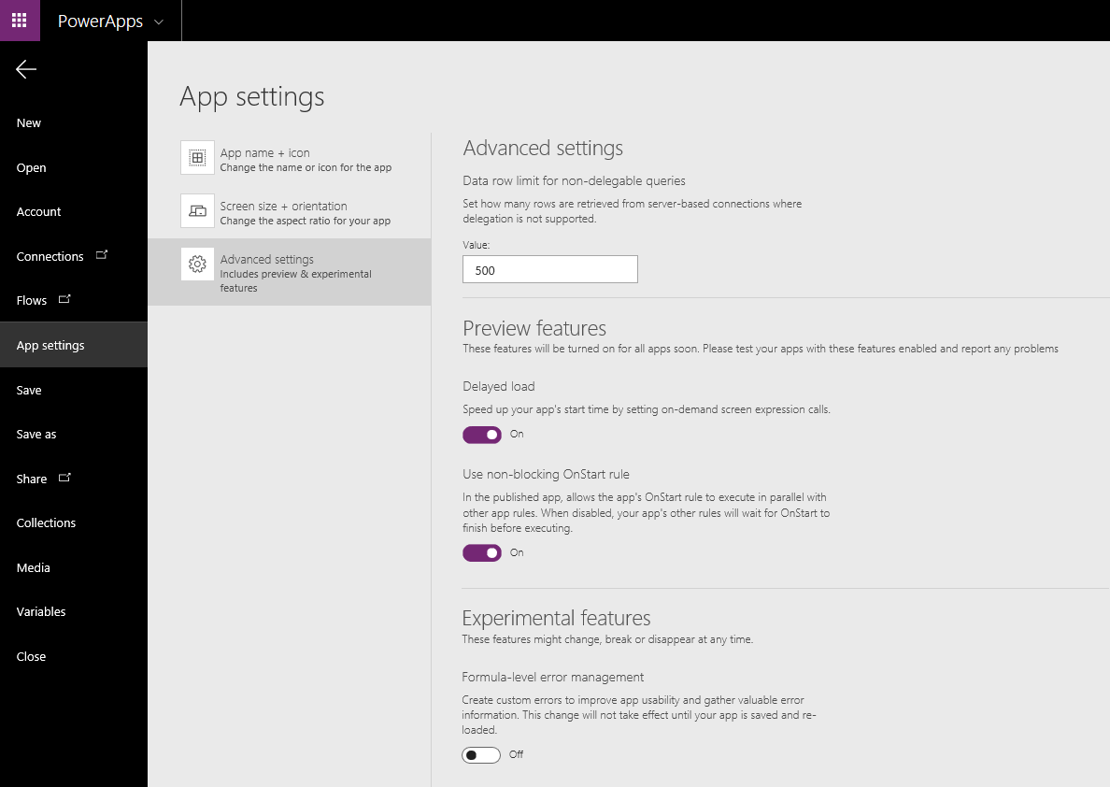
Enable the Preview features

Slide 9
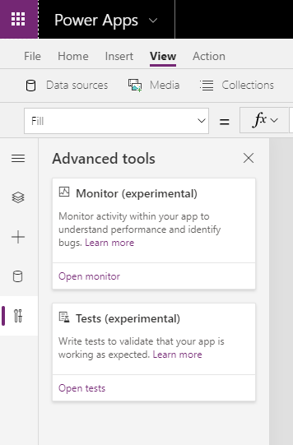
Opening Test Studio

Slide 10
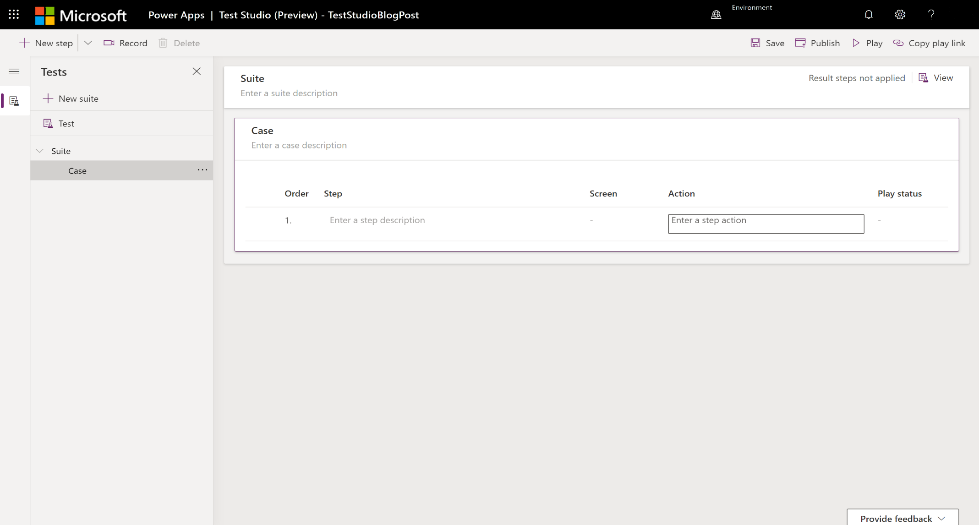
Test Studio landing page
.

Slide 11
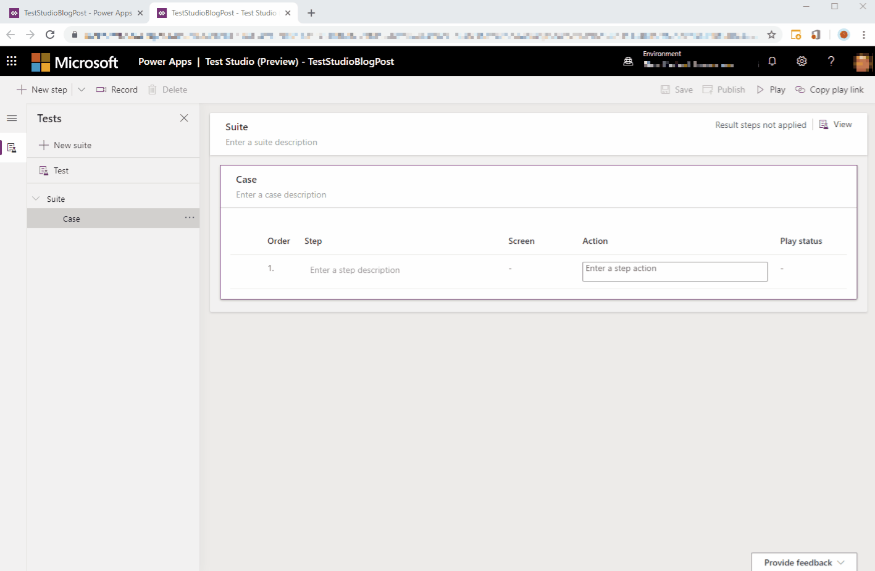
Creating a new test case
.

Slide 12
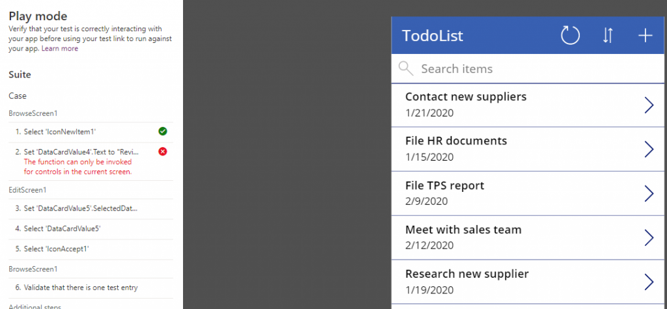
Detecting problems in the app
.

Slide 13
Log telemetry for your Apps using Azure Application Insights
Would you like to know how many people are using your App ?
where they are accessing it from ?
what screens are most visited ?
the devices or browsers that are most popular?
maybe you want to monitor all errors presented to your users, and using this data, get automatically alerted if errors suddenly increase?
With your app connected to Azure Applications Insights, you can now begin to gather this information to help you drive better business decisions and improve the quality of your apps.

Slide 14
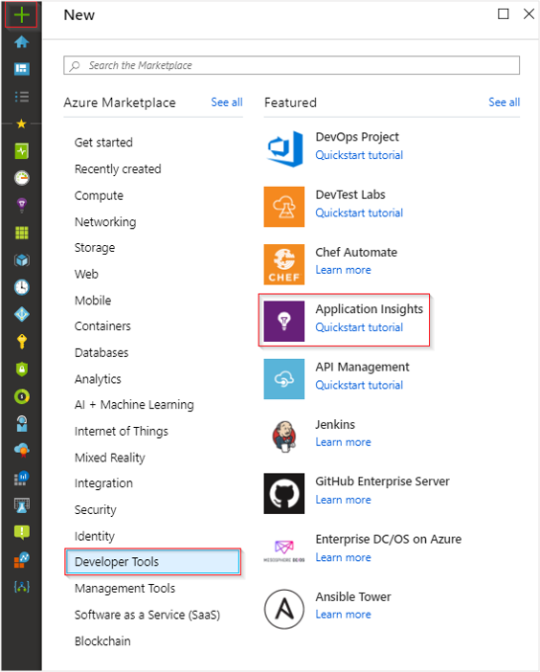
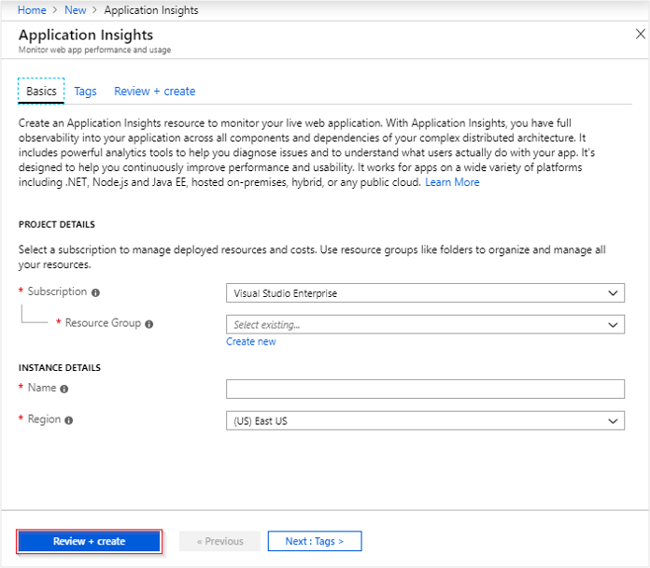
Create an Application Insights resource
Sign in to the Azure portal, and create an Application Insights resource:

Slide 15
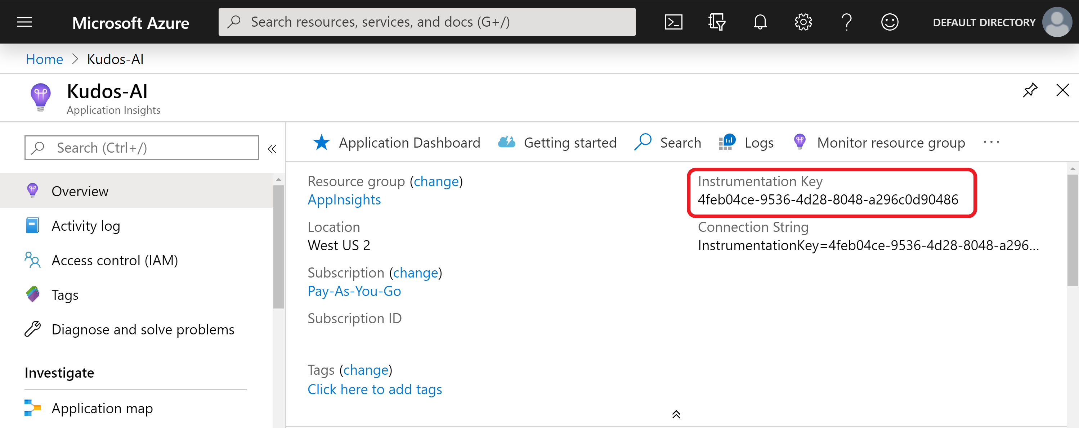
After you create your App Insights resource, you are going to need the instrumentation key so copy or take a note of this value.

Slide 16
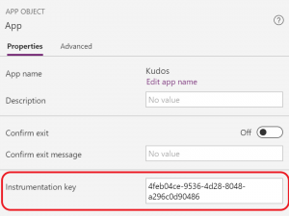
Connect your app to Application Insights
Open your app and the select the App object. In the App object panel, update the Instrumentation key property to your Azure App Insights instrumentation key. After you update the instrumentation key, save and publish your app.

Slide 17
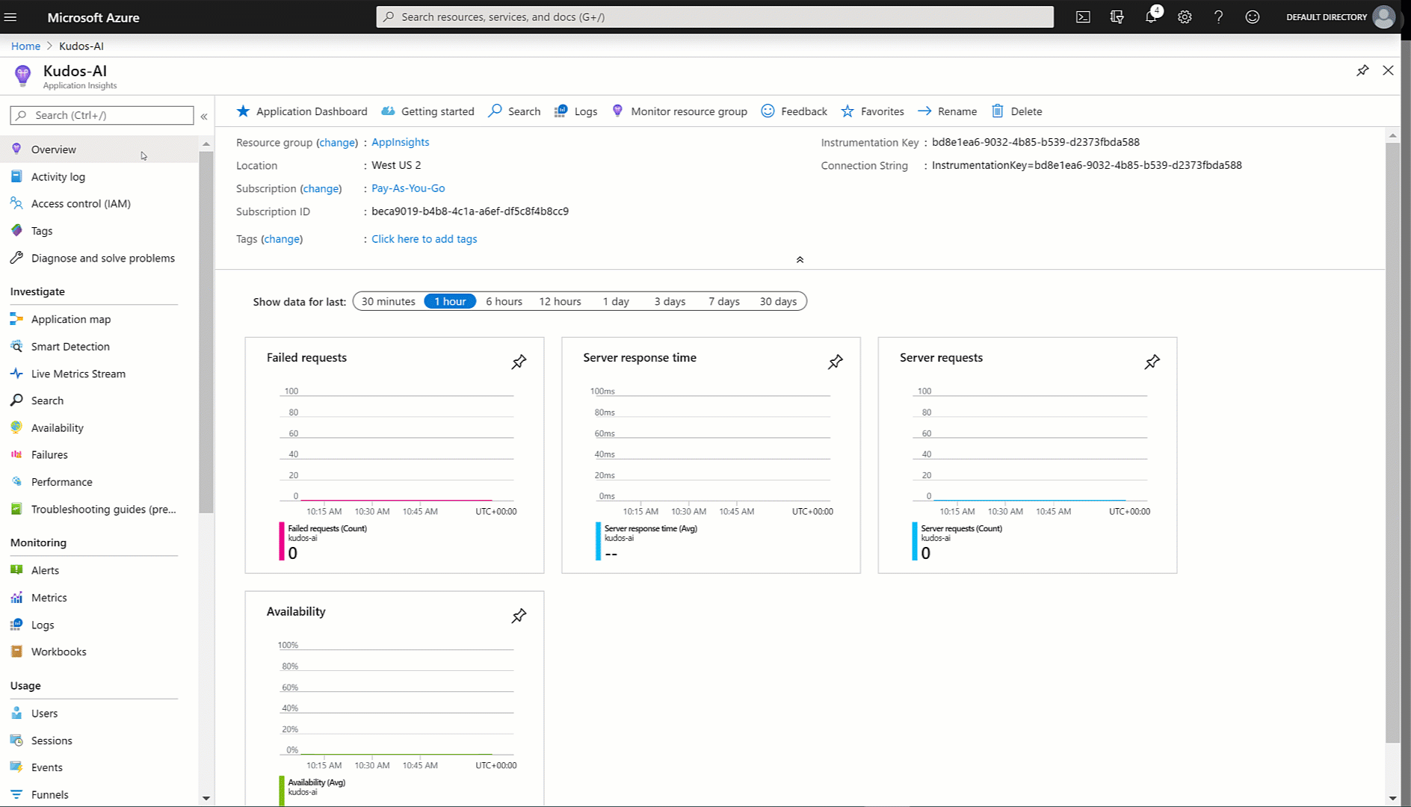
Great! That’s all you need to start gathering telemetry for the app!

Slide 18
Demo

Slide 19
References
PowerApps Overview Documentation:
https://docs.microsoft.com/en-us/powerapps/powerapps-overview
PowerApps Formula References:
https://docs.microsoft.com/en-us/powerapps/maker/canvas-apps/formula-reference
PowerApps and Microsoft Flow: Learning Resources:
https://powerapps.microsoft.com/en-us/blog/microsoft-powerapps-learning-resources/
https://powerapps.microsoft.com/en-us/blog/introducing-test-studio-to-build-end-to-end-tests-and-maintain-your-app-quality/
PowerApps - Learn more through tutorials and demos:
https://powerusers.microsoft.com/t5/Community-Video-Gallery/bd-p/VideoGallery

Slide 20
Any Questions?

Slide 21
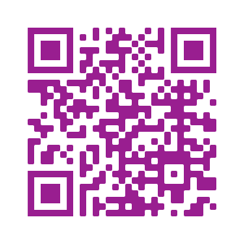
Please fill out the survey! & Win Swags!!
https://www.powerplatformbootcamp.com/survey

Slide 22
Thank You For Attending

